Slide 1

WorkshopPLUS - Building Cloud-native Applications using Microservices Architecture

Slide 3
Module 4 – Advanced Container Topics

Slide 4
Agenda
Managing Data
Managing Resources
Docker Networking
Docker Container Security
Docker Compose

Slide 5
Managing Data
The data doesn’t persist when that container no longer exists, and it can be difficult to get the data out of the container if another process needs it
A container’s writable layer is tightly coupled to the host machine where the container is running. You can’t easily move the data somewhere else
Writing into a container’s writable layer requires a storage driver to manage the filesystem
Notes:
Manage data in Docker | Docker Documentation

Slide 6
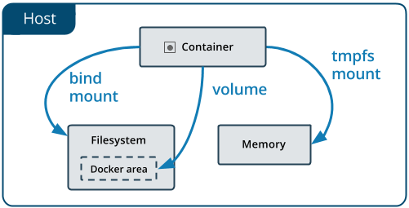
Options for storing data
On Host Machine
Volumes
Bind Mounts
In-memory (not persisted)
tmpfs mounts (linux)
npipe pipes (windows)
Notes:
tmpfs mounts: A tmpfs mount is not persisted on disk, either on the Docker host or within a container. It can be used by a container during the lifetime of the container, to store non-persistent state or sensitive information. For instance, internally, swarm services use tmpfs mounts to mount secrets into a service’s containers.
named pipes: An npipe mount can be used for communication between the Docker host and a container. Common use case is to run a third-party tool inside of a container and connect to the Docker Engine API using a named pipe.

Slide 7
Choosing the right type of mount
Volumes are stored in a part of the host filesystem which is managed by Docker
Non-Docker processes should not modify this part of the filesystem.
Volumes are the best way to persist data in Docker.
Bind mounts may be stored anywhere on the host system
They may even be important system files or directories.
Non-Docker processes on the Docker host or a Docker container can modify them at any time.
tmpfs mounts are stored in the host system’s memory only
never written to the host system’s filesystem.
npipe mount can be used for communication between the Docker host and a container

Slide 8
Use cases for Bind, tmpfs and npipe mounts
Bind Mount:
Sharing config files from the host to the containers
Sharing source code or build artifacts between dev environment on the Docker host and a container
File/Directory structure of Docker host is guaranteed to be consistent
tmpfs Mount:
mounts are best used for cases when you do not want the data to persist either on the host machine or within the container
This may be for security reasons or to protect the performance of the container when your application needs to write a large volume of non-persistent state data
Named pipes:
run a third-party tool inside of a container and connect to the Docker Engine API using a named pipe
Notes:
Named Pipes - Win32 apps | Microsoft Docs

Slide 9
Use Volumes whenever possible
Created explicitly using docker volume create, or created during container/service creation
R/W or RO
Decouple the configuration of the Docker host from the container runtime
When the mounted container is removed, the volume still exists
A given volume can be mounted into multiple containers simultaneously
Support the use of volume drivers, allowing data storage on remote hosts or cloud providers
Notes:
Manage data in Docker | Docker Documentation

Slide 10
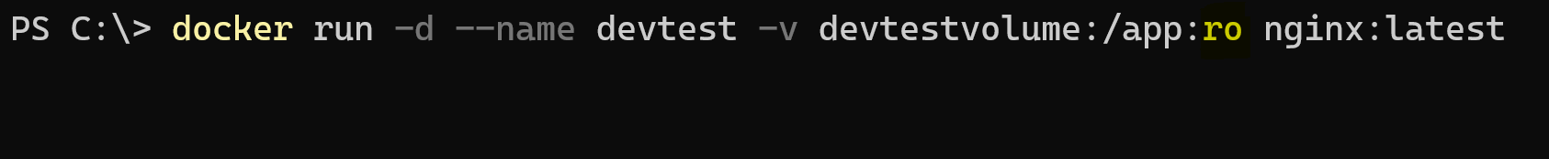
Syntax -v or --volume
Consists of three fields, separated by colon characters (:).
The fields must be in the correct order
The meaning of each field is not immediately obvious
In the case of named volumes, the first field is the name of the volume, and is unique on a given host machine. For anonymous volumes, the first field is omitted.
The second field is the path where the file or directory are mounted in the container.
The third field is optional, and is a comma-separated list of options, such as ro (read-only)

Slide 11
Syntax --mount
Consists of multiple key-value pairs, separated by commas and each consisting of a <key>=<value> tuple
The type of the mount, which can be bind, volume, or tmpfs
The source of the mount and for named volumes, this is the name of the volume
May be specified as source or src
The destination is value the path where the file or directory is mounted in the container
May be specified as destination, dst or target
The readonly option, if present, mounts bind mount to the container as read-only
May be specified as readonly or ro.
The volume-opt option, which can be specified more than once, takes a key-value pair consisting of the option name and its value.

Slide 12
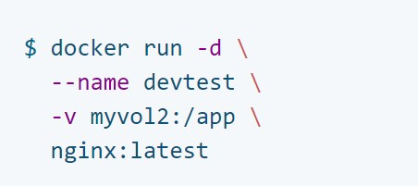
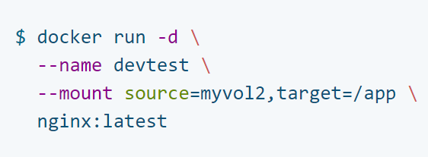
Syntax – what to choose?
--mount is more explicit and verbose
-v combines all the options together in one field while --mount syntax separates them
If you need to specify volume driver options, you must use --mount

Slide 13
Demo: Working with Data Volumes
Notes:
Mounting the bind mount with nanoserver or servercore images.
Mounting the volume with nanoserver or servercore images

Slide 14
Managing Resources

Slide 15
Docker Resource Constraints
By default, a container has no resource constraints and can use as much of a given resource as the host’s kernel scheduler allows
Docker provides ways to control how much memory, or CPU a container can use, setting runtime configuration flags of the docker run command
Many of these features require your kernel to support Linux capabilities
In order to use GPU you have to install the Nvidia Driver and configure for use

Slide 16
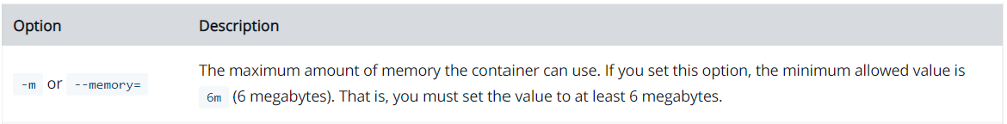
Limiting container’s access to memory
It is important not to allow a running container to consume too much of the host machine’s memory, causing OOME
Docker can enforce:
Hard memory limits
allow the container to use no more than a given amount of user or system memory
Soft limits
which allow the container to use as much memory as it needs unless certain conditions are met, such as when the kernel detects low memory or contention on the host machine.
Notes:
OOME – Out of memory exception
https://docs.docker.com/config/containers/resource_constraints/

Slide 17
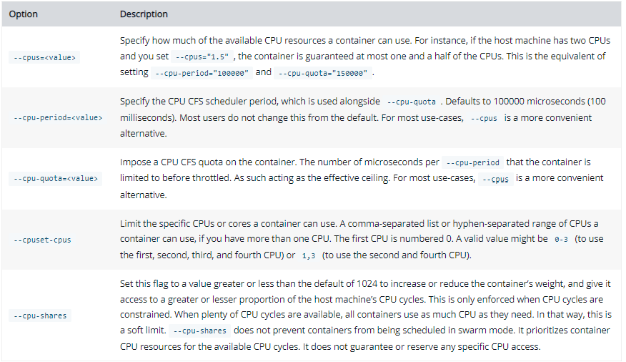
Limiting container’s access to CPU
By default, each container’s access to the host machine’s CPU cycles is unlimited
You can set various constraints to limit a given container’s access to the host machine’s CPU cycles
Notes:
OOME – Out of memory exception
https://docs.docker.com/config/containers/resource_constraints/

Slide 18
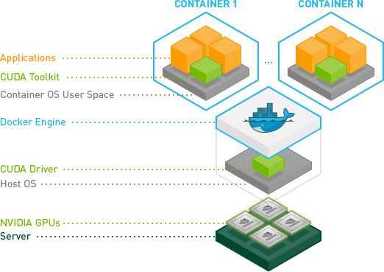
Accessing host GPU within a container
GPU is not configured when you run a Docker container
The NVIDIA Container Toolkit allows users to build and run GPU accelerated Docker containers
Steps:
Install NVIDIA driver
Register nvidia-runtime
GPUs can be specified to the Docker CLI using either the --gpus option starting with Docker
Example:
Notes:
OOME – Out of memory exception
https://docs.docker.com/config/containers/resource_constraints/
https://www.nvidia.com/Download/index.aspx

Slide 19
Demo: Launching containers with Memory and CPU constraints
Notes:
Lauch the containers with the memory and CPU constraints.
Check the docker stats to show the memory/cpu usage

Slide 20
Docker Networking

Slide 21
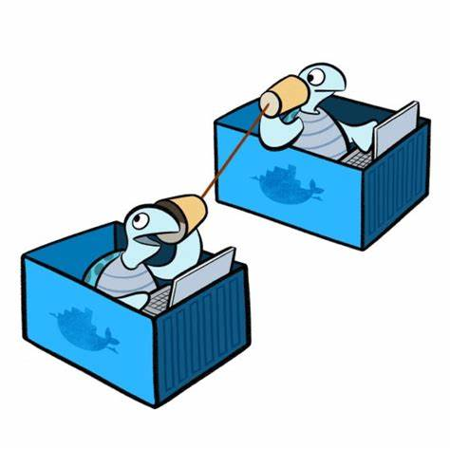
Networking Overview
One of the reasons Docker containers and services are so powerful is that you can connect them together, or connect them to non-Docker workloads
Docker containers and services do not even need to be aware that they are deployed on Docker, or whether their peers are also Docker workloads or not
Use Docker to manage the networking in platform-agnostic way

Slide 22
Network drivers – Linux
bridge:
The default network driver.
If you don’t specify a driver, this is the type of network you are creating. Bridge networks are usually used when your applications run in standalone containers that need to communicate
host:
For standalone containers, remove network isolation between the container and the Docker host, and use the host’s networking directly
overlay:
Overlay networks connect multiple Docker daemons together and enable swarm services to communicate with each other. You can also use overlay networks to facilitate communication between a swarm service and a standalone container, or between two standalone containers on different Docker daemons.
ipvlan:
IPvlan networks give users total control over both IPv4 and IPv6 addressing
macvlan:
Assign a MAC address to a container, making it appear as a physical device on your network.
Best choice when dealing with legacy apps that expect to be directly connected to the physical network, rather than through the Docker host’s network stack
none:
Disable all networking for container
Network plugins:
Install and use third-party plugins
Notes:
Network driver summary
User-defined bridge networks are best when you need multiple containers to communicate on the same Docker host.
Host networks are best when the network stack should not be isolated from the Docker host, but you want other aspects of the container to be isolated.
Overlay networks are best when you need containers running on different Docker hosts to communicate, or when multiple applications work together using swarm services.
Macvlan networks are best when you are migrating from a VM setup or need your containers to look like physical hosts on your network, each with a unique MAC address.
Third-party network plugins allow you to integrate Docker with specialized network stacks.

Slide 23
Network drivers – Windows
NAT:
Containers attached to a network created with the 'nat' driver will be connected to an internal Hyper-V switch and receive an IP address from the user-specified (--subnet) IP prefix
Port forwarding / mapping from the container host to container endpoints is supported
Transparent:
Containers will be directly connected to the physical network through an external Hyper-V switch
Ips can be assigned statically or dynamically through DHCP
Overlay:
Network is created with its own IP subnet, defined by a private IP prefix
Containers attached to an overlay network can communicate with other containers attached to the same network across multiple container hosts
L2bridge:
Containers will be connected to the physical network through an external Hyper-V switch
Network traffic will have the same MAC address as the host due to Layer-2 address translation (MAC re-write) operation on ingress and egress
L2tunnel:
This driver should only be used in a Microsoft Cloud Stack (Azure)
Notes:
Windows container network drivers | Microsoft Docs

Slide 24
Managing networks
List all the networks available
docker network ls
Command to create new network
docker network create -d nat --subnet=192.168.15.0/24 --gateway=192.168.15.1 custom-nat
Create a new container attached to the user-defined nat
docker run -d --network=custom-nat mcr.microsoft.com/windows/nanoserver:20H2 ping -t localhost
Command to connect a container to user-defined nat (custom-nat)
docker network connect my-container custom-nat
Command to disconnect a container to user-defined nat (custom-nat)
docker network disconnect my-container custom-nat
Notes:
Network containers | Docker Documentation
Use bridge networks | Docker Documentation
Windows container networking | Microsoft Docs

Slide 25
Docker Container Security

Slide 26
Best Security Practices for Containers
As a developer, you can take a few simple steps to improve the security of your container:
Choosing the right base image from a trusted source and keeping it small
Using multi-stage builds
Rebuilding images
Scanning images during development
Scanning images during production

Slide 27


Choose the right base image
When choosing an image, ensure it is built from a trusted source and keep it small
When you pick your base image, look out for the and badges.
When building your own image from a Dockerfile, ensure you choose a minimal base image that matches your requirements
Better portability and faster downloads
Minimizes the number of vulnerabilities introduced through the dependencies
Recommendation is to use two types of base images:
Image for development and unit testing
Image for testing during the latest stages of development and production and exclude build tools such as compiles, build systems or any debugging tools to lower the attack surface
Notes:
Best practices for scanning images | Docker Documentation
In the later stages of development, your image may not even require some build tools such as compilers, build systems, or any debugging tools. A small image with minimal dependencies can considerably lower the attack surface.

Slide 28
Use multi-stage builds
Multi-stage builds are designed to create an optimized Dockerfile that is easy to read and maintain
selectively copy artifacts from one stage to another, leaving behind things you don’t need in the final image, creating a concise final image
This does not only reduce complexity, but also allows you to omit the vulnerable artifacts from underlying images
Multi-stage builds allow you to ‘cherry pick’ your artifacts without inheriting the vulnerabilities from the base images on which they rely on
Notes:
Best practices for scanning images | Docker Documentation

Slide 29
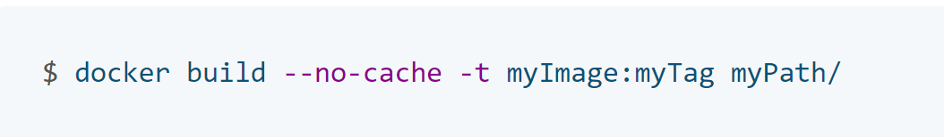
Rebuild images
Building your image is a snapshot of that image, at that moment in time
When you depend on a base image without a tag, you’ll get a different base image every time you rebuild
It’s recommended that you rebuild your Docker image regularly to prevent known vulnerabilities that have been addressed
When rebuilding, use the option --no-cache to avoid cache hits and to ensure a fresh download
Notes:
Best practices for scanning images | Docker Documentation

Slide 30
Scan images during development
Scanning your Docker images during development should be part of your workflow to catch vulnerabilities earlier in your development
Include image scanning at all stages of development
Consider automating the scans
During the build process
Before pushing the image to container registry
Before pushing it to production environment
Docker and Snyk have partnered together to provide a simple approach for developers to build and deploy secure containers
You can achieve this either through the docker scan command in the CLI, or through Docker Hub (10 free scans per month)
Notes:
Best practices for scanning images | Docker Documentation

Slide 31


Scan images during production
Actively scan your images for new vulnerabilities
Save yourself a lot of hassle when the new vulnerability is discovered
Many container security tools available that would help you scan docker container images for security vulnerabilities, malware, configuration issues to deviations in expected behavior using the latest threat intelligence and machine learning during the CI/CD pipeline build, in the registry and at runtime
Most recommended for the Azure hosting environment:

Slide 32
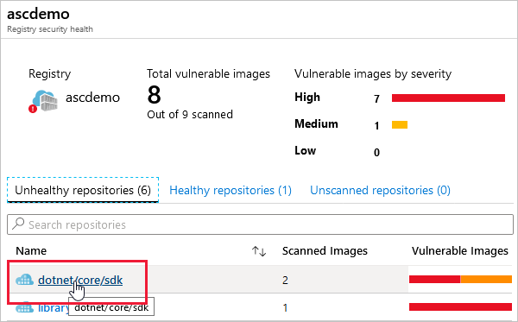
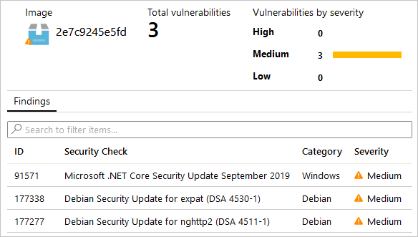
Microsoft Defender for Containers
Microsoft Defender for Containers is the cloud-native solution for securing your containers
Identify vulnerabilities in images in other container registries
View/remediate findings or disable if want to ignore it
Scan images in CI/CD pipelines
Notes:
How to use Defender for Containers | Microsoft Docs

Slide 33
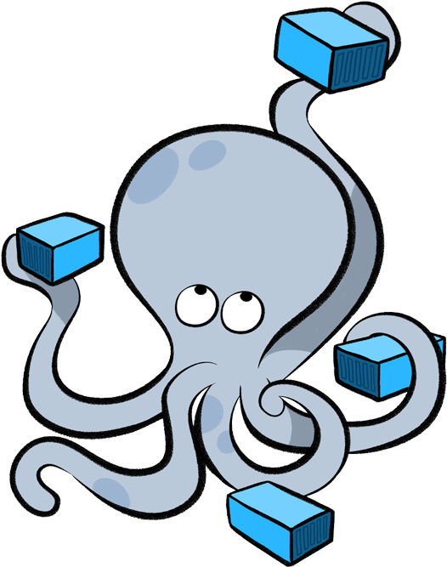
Docker Compose

Slide 34
Docker Compose
Defining and running complex apps has never been so easy
Compose is a tool for defining and running multi-container Docker applications
With Compose, you use a YAML file to configure your application’s services
Then, with a single command, you create and start all the services from your configuration

Slide 35
Docker Compose
Compose has commands for managing the whole lifecycle of your application:
Start, stop, and rebuild services
View the status of running services
Stream the log output of running services
Run a one-off command on a service
Compose works in all environments: production, staging, development, testing, as well as CI workflows
Ideal for development environments, automated testing and single host deployments

Slide 36
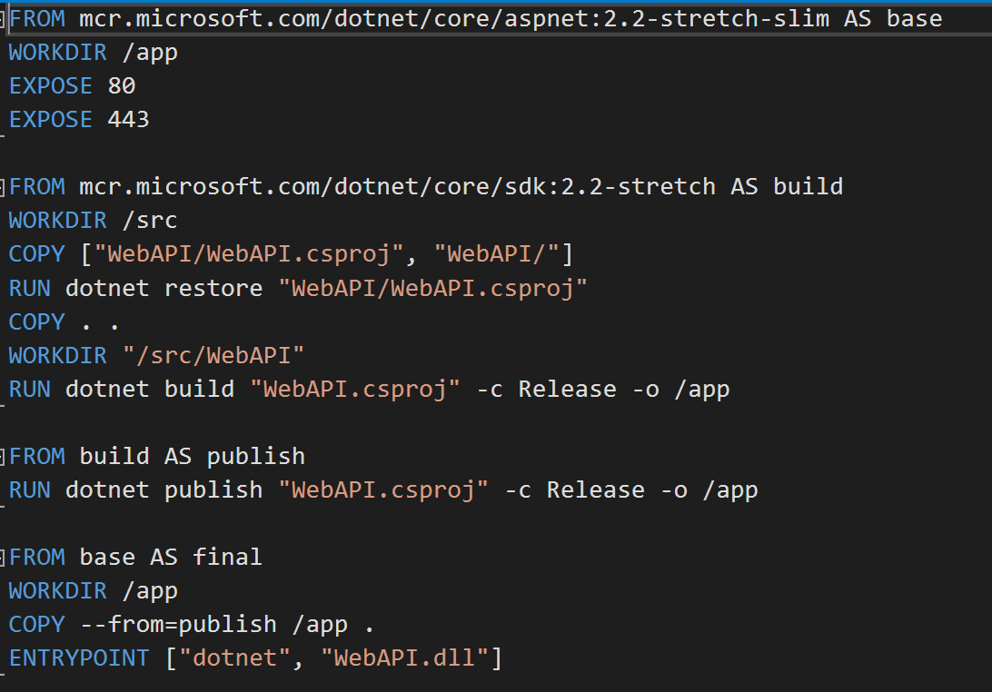
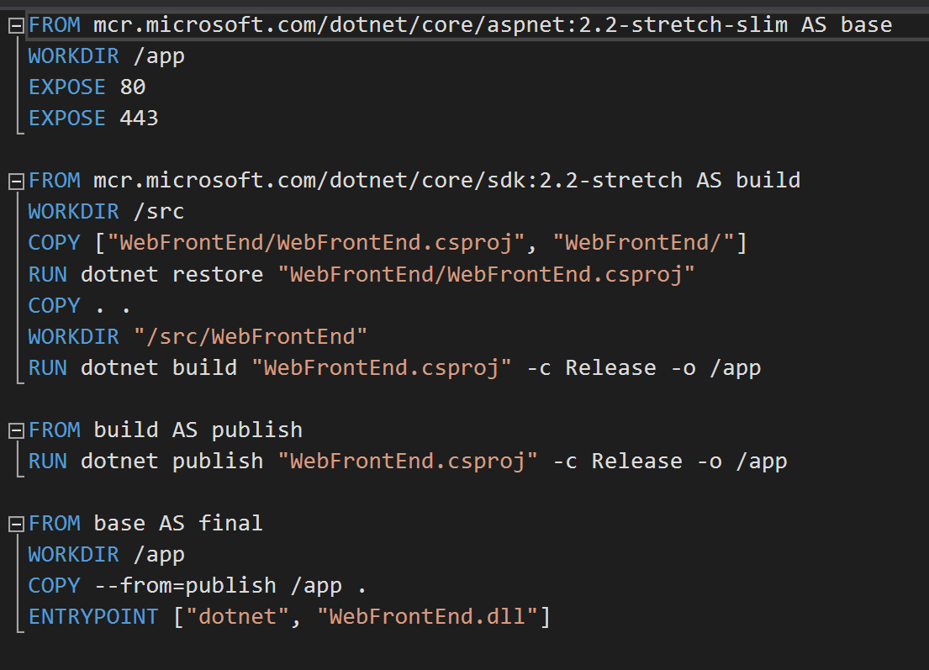
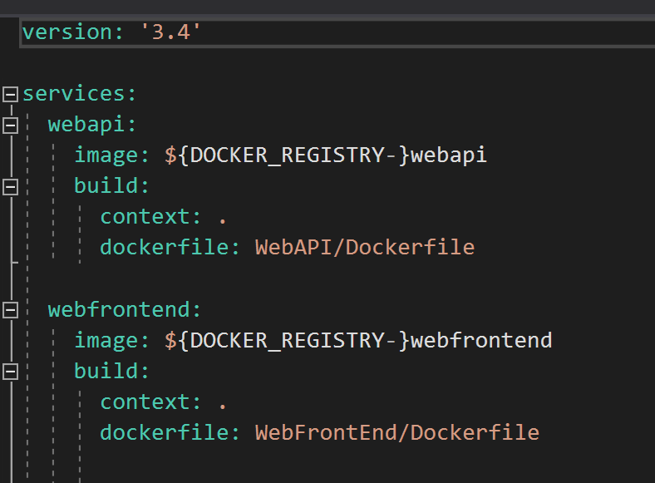
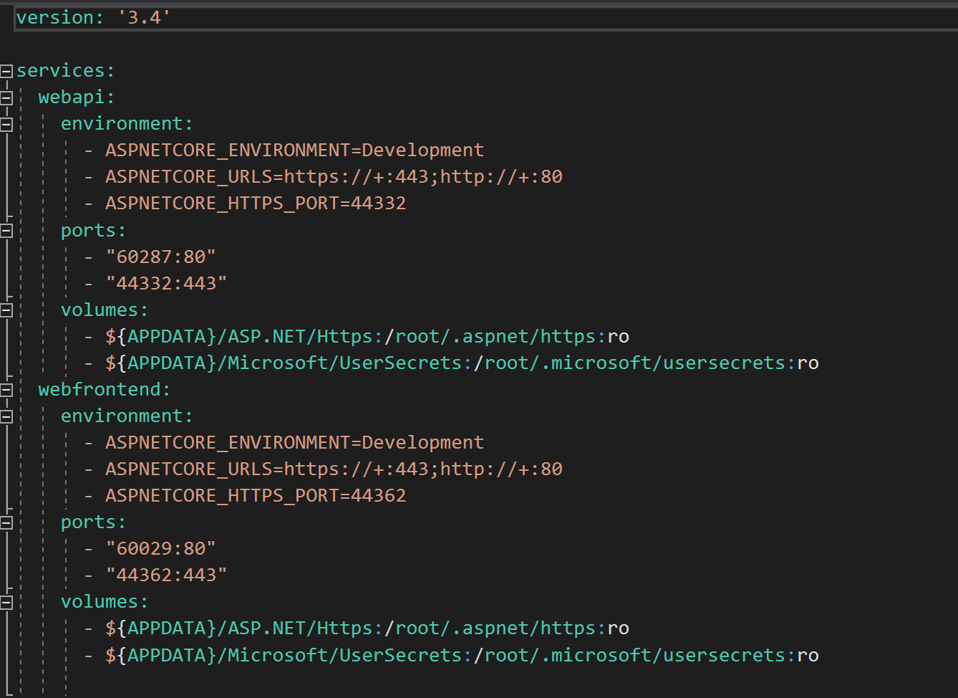
Using Docker Compose
Define your app’s environment with a Dockerfile so it can be reproduced anywhere
Define the services that make up your app in docker-compose.yml so they can be run together in an isolated environment
Run docker-compose up and Compose will start and run your entire app
Dockerfile | webapi
Dockerfile | webapp
Docker-Compose.yaml
Docker-Compose-Override.yaml
Notes:
Compose caches the configuration used to create a container. When you restart a service that has not changed, Compose re-uses the existing containers. Re-using containers means that you can make changes to your environment very quickly.
Compose supports variables in the Compose file. You can use these variables to customize your composition for different environments, or different users.
Build > Target: Build the specified stage as defined inside the Dockerfile. See the multi-stage build docs for details.

Slide 37
Demo: Launching Microservices App locally using Docker Compose
Notes:
Use docker compose to launch microservices app locally
List containers using the docker ps command
Open up the front end with the port exposed.

Slide 38

Lab – Module 5 Container Advanced Scenarios

Slide 39
Thank you

